Slide 1
Access Management

Slide 2





1. Access Management
3

Slide 3
How is it different from Identity Management
Identity Management involves who you are and how that is recorded
“Where as”
Access management involves policies around how you access the resources

Slide 4
2. Authentication

Slide 5

Authentication
Authentication is a process in which the credentials provided are compared to those on file in a database of authorized users' information on a local operating system or within an authentication server. If the credentials match, the process is completed and the user is granted authorization for access.

Slide 6
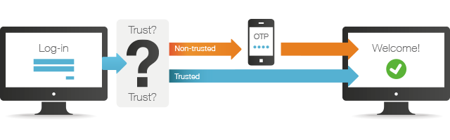
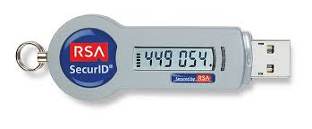
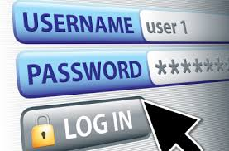
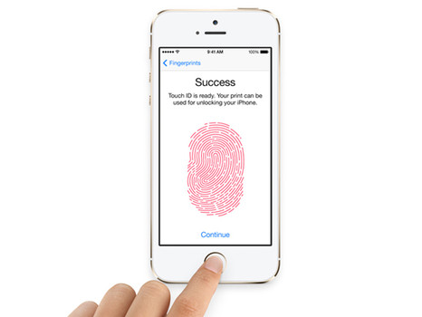
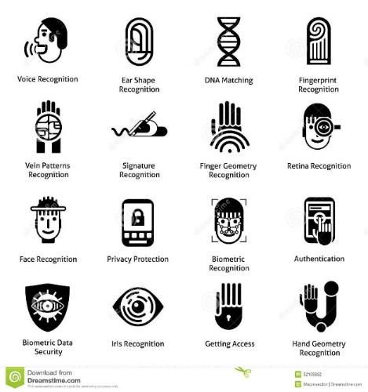
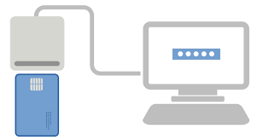
Authentication - Types
One Time Passwords
Cryptographic Keys
Password Authentication
Biometric Authentication
Finger Print Authentication
Smart Card Authentication

Slide 7
Authentication - Approaches
Something you know
Password
Something you are
Fingerprint
Iris
Something you have
Token
Smartcard
Passphrase

Slide 8
3. Authorization

Slide 9
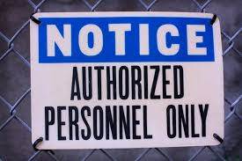
Authorization
Authorization is the function of specifying access rights to resources related to information security and computer security in general and to access control in particular.

Slide 10
Web Access Management

Slide 11
1. Web Access Management

Slide 12
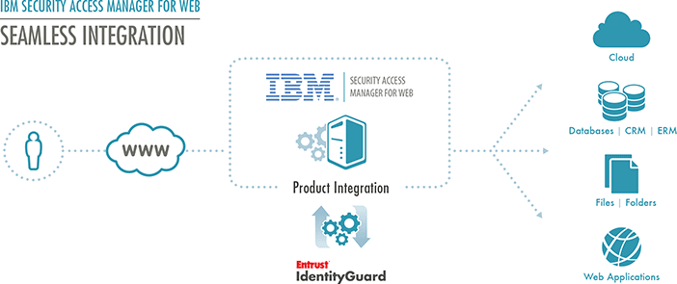
What is WAM?
Web Access Manager Solution
Web access management (WAM) is a process for identity authentication for Web access. It is a form of access and identity management which controls access to Web resources like Web servers and secure servers by providing authentication management through policy-based authorizations as well as audit and report services.

Slide 13
2. Architecture

Slide 14
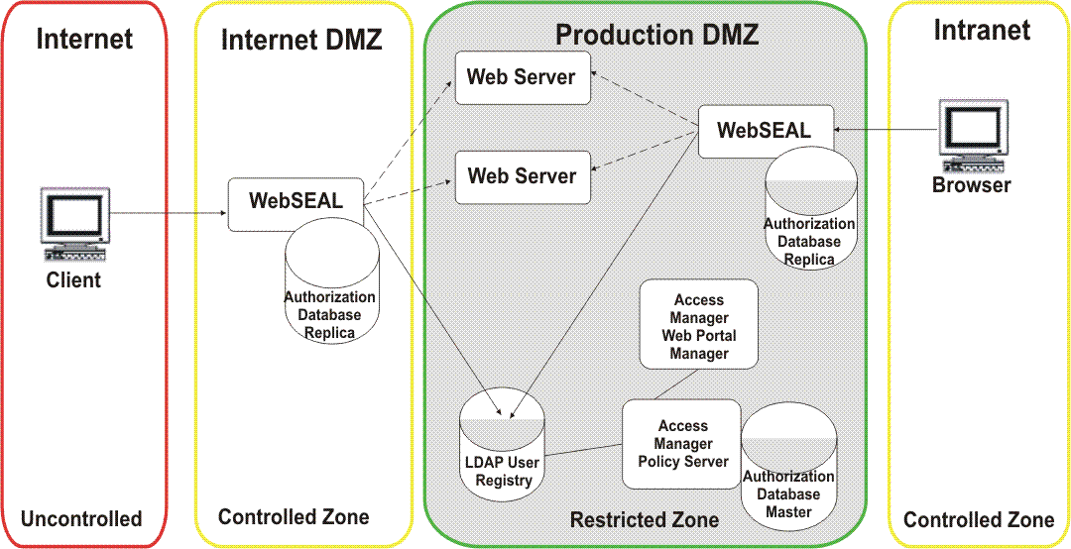
WAM Architecture - Example
Web Access Manager
Web Access Manager

Slide 15
3. Authentication Scenarios

Slide 16


UserID Password Based
Transform password to salted hash format
Save the user registration details including Login Id password
Personal details
Login Id
Password
Register
End User
Login
Is Login Id present in the store
Transform the submitted password to a salted hash format and compare it with salted hash password in the store
Store
Login Id
Password
Authentication is successful if salted hash passwords match

Slide 17
One Time Password Based
Generate random number
Format the random number for it to be human readable and to be typed using a keyboard
Transform formatted random number to salted hash format
Save the salted hash random number and its time of expiry
Login
Critical Functionality
End User
One time password sent out-of-band
Is Login Id present in the store
Is the one time password valid (not expired)
Transform the submitted One Time password to a salted hash format and compare it with salted hash password in the store
SMS
Email
Scratch card etc.
One time password
3
Store
Authentication is successful if salted hash One time passwords match

Slide 18
Digital Certificate Based
Login Id
Signed Data
Fetch User certificate from store
Verify signature
End User
Login
Store
Authentication is successful if digital signature verification is successful

Slide 19
Access Management Products
Vendor | Tool
Oracle | Oracle Access Manager- 11gR2PS3
IBM | Tivoli Access Manager (now IBM Security Access Manager) - IBM Security Access Manager 9.0.6
Novell | NetIQ Access Manager 4.0 SP2
CA Technologies | CA Siteminder
ForgeRock | ForgeRock OpenAM-14.1.1
Dell | Dell One Identity Cloud Access Manager 8.0

Slide 20
Adaptive/Risk Based Authentication

Slide 21
1. Adaptive/Risk Based Authentication

Slide 22
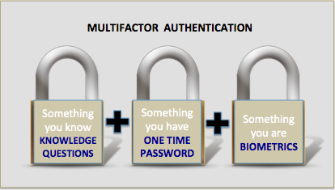
Authentication Factors
Three general factors used for Authentication:
Something a person has;
E.g., Key, swipe card, access card, badge, etc.
Downside to this factor is that things can be lost.
This is commonly used to access facilities.
Something a person knows; and
E.g. password, PIN, combination to a lock, etc.
This is usually the least expensive to implement.
Downside is that an unauthorized person could discover this knowledge.
Something a person is:
E.g., based on a physical attribute (Biometrics)
Most expensive way to prove identity, also has difficulties with user acceptance.
*Multi-factor or Strong Authentication contains any 2 out of 3 of the above methods.
Authentication - Method of proving the identity, which is a process of determining whether a user is, who he or she claims to be.

Slide 23

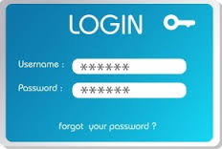
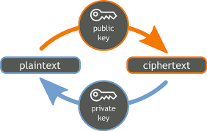
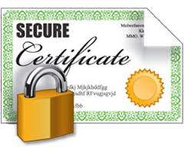

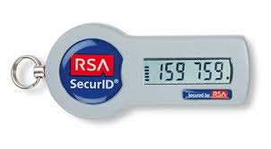
Ways of Authentication
Username & Password
Finger Print Scan
Public Key Cryptography
Digital Certificates
Iris Scan
Secure Token

Slide 24

What is Risk Based Authentication (RBA)
RBA is a method of applying varying levels of stringency to authentication.
Developing a risk score for each log-in attempt, and
Weighing this score against allowable risk thresholds for various systems.
As the level of risk increases, the authentication process becomes more comprehensive and restrictive
In simple words –
Authenticating users based on analysis of client’s device and
If a particular device is user’s usual device or a new one by comparing it with the history
User’s behavior - is it usual like previous authentication or different
Risk-based authentication can be categorized as either
User-dependent
Employs the same authentication for every session initiated by a given user;
Transaction-dependent
Different authentication levels may be required of a given user in different situations
Based on the sensitivity or risk potential of the transaction

Slide 25
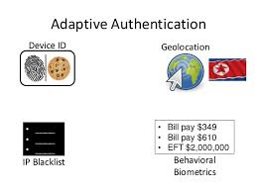
Why and When Risk Based Authentication
WHY
To reduce fraud and protect users from internet attacks.
Provides the organizations the ability to enforce different levels of authentication depending on
User Activity
Transaction Value
Calculated risk score
WHEN
Organizations have large user base spread across geography
Most of the users come from unsecure environment and carry out financial transactions.
Cost of managing end user profile is very high. Example: Distribute hard token etc.
Risk factors vary dynamically based on geography, transaction, user access behavior
New device types like smart phone etc. are used by end users to access applications

Slide 26

Typical Business Challenges
Increased attacks on the business transaction
Increased rate of Fraud going undetected
Global access to sensitive transactions
Government Regulations and compliance requirements
Protect user identities from online attacks
Security for mobile devices
Protect user passwords from theft or breach
Better Security / More users
Consumerization of IT / Multiple devices
TCO and Recovery

Slide 27
2. Solution Overview & Information flow

Slide 28
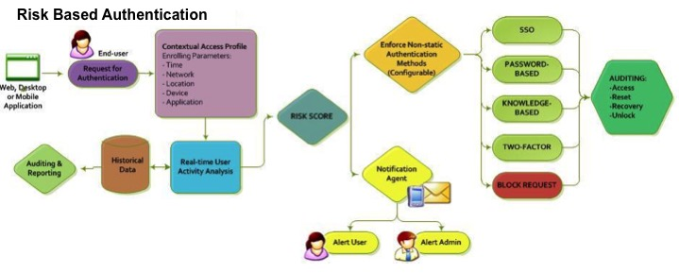
Risk Based Authentication Flow

Slide 29
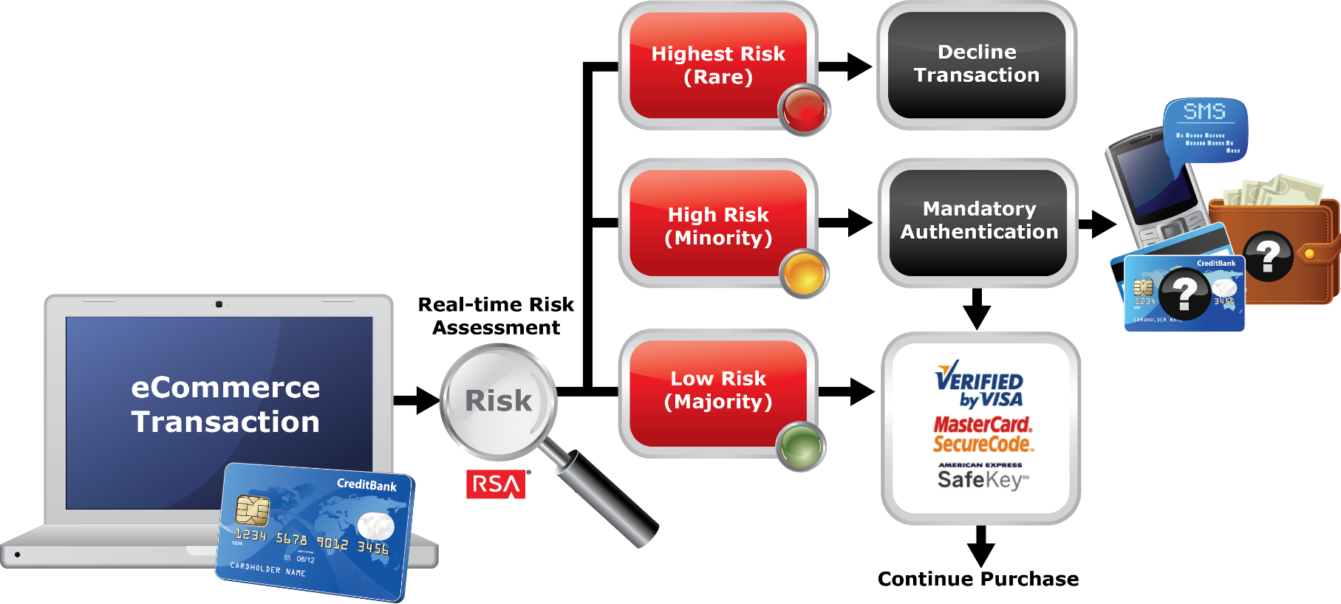
High Level Architecture

Slide 30
The Dynamics of Risk-based Authentication
Device Profiling
Includes scanning for previous devices used by user and their types(i.e. laptops or desktop or mobile device)
Includes – Unique Device Identification and Device Fingerprinting
Behavioral Profiling
Study of user behavior and comparison with previous interactions
Velocity checking, IP address information, and time of day comparisons
Risk Engine
Self learning statistical machine
Utilizes many indicators to evaluate a risk of an activity in real-time
Generates an unique score for each activity
Score is the reflective of the above mentioned device or behavioral profiling

Slide 31
3. Risk Engine, Device Profiling & Use cases

Slide 32
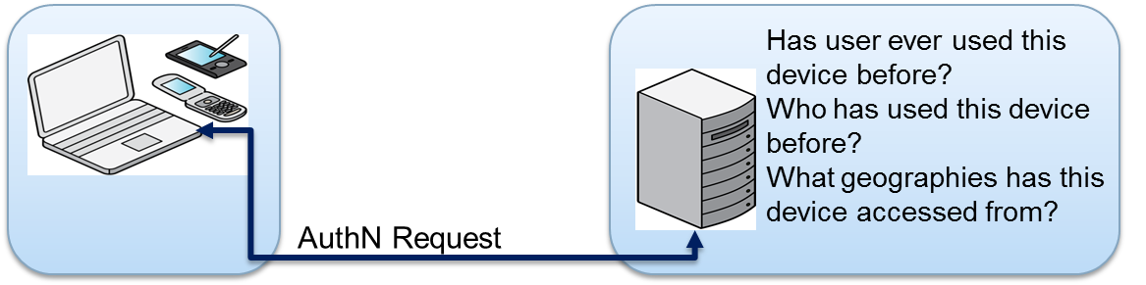
Device Profiling
Notes:
Device profiling features are nowadays provided by Access Manager products. There are varied levels of device profiling techniques possible. These are configured based on requirements and also based on the type of user and the sensitivity and criticality of services/applications that are being accessed. For example, a high net worth customer can have the more sophisticated device profiling functionalities configured which a normal user may not have been configured with.

Slide 33
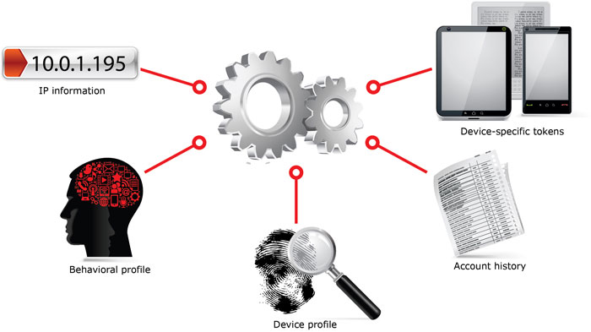
Introduction to Risk Engine
Salient Features:
Collects and analyzes vast amounts of login and transactional data from multiple channels
Compiles the risk assessment based on the collected data
Self –learning statistical model
Evaluation each online activity in real time
Tracking many (100+) indicators in order to detect suspicious activity
A unique risk score, between 0 and 1000.
Higher the score higher the risk

Slide 34
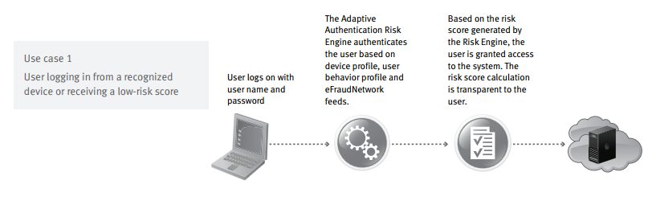
Use Cases -1

Slide 35
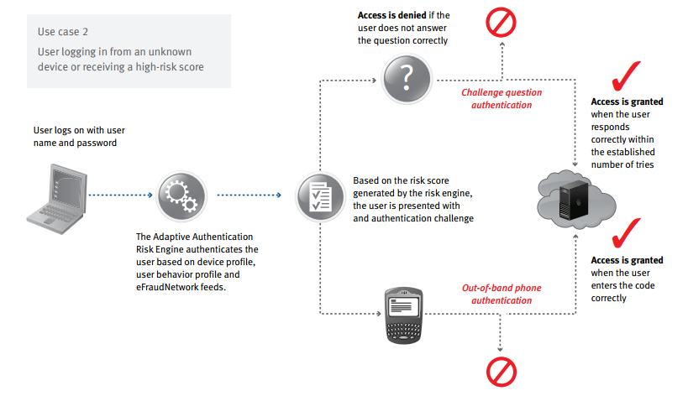
Use Cases -2

Slide 36
Thank You

